Slide 1
A Comprehensive IoT-Fog-Cloud Architecture for Healthcare Monitoring

Slide 2
objective
The main objective of this project is to develop a comprehensive IoT-Fog-Cloud architecture for real-time healthcare monitoring. The system is designed to provide efficient and reliable data processing, prioritizing a low latency response for critical tasks.

Slide 3
Simulation Plan (expanded): Specified simulator options (iFogSim or Python prototype), 300 tasks, and scenarios to compare
(Random vs WSM+MBAR). Metrics: Latency, Miss Ratio, Average Delay, Cost/Execution, Resource Utilization.
Edge Code Implementation (Python snippet):
Added a concise WSM (priority formula) and MBAR allocation example in Python for quick demo in the presentation.
GitHub Contributions (proof slide):
Each member’s contribution listed and placeholder for commit screenshots / links.

Slide 4
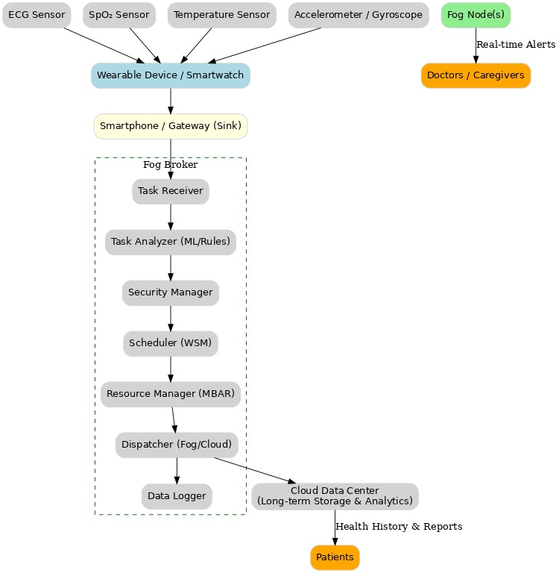
Revised Architecture diagram

Slide 5
Layers:
IoT Devices: Sensors collecting patient data in real-time.
Sink Layer: Gateways aggregating and filtering data.
Fog Layer: Real-time processing, emergency detection, WSM + MBAR algorithms.
Cloud Layer: Long-term storage, analytics, historical insights.

Slide 6
Metrics to Evaluate:
We will measure the following to assess our system's efficiency and reliability:
Latency: To ensure real-time response for critical tasks.
Miss Ratio: To track the percentage of tasks that fail to meet their deadlines.
Resource Utilization: To evaluate the efficiency of our resource management.
Cost per Execution: To analyze the overall cost-effectiveness of our approach.

Slide 7
Enhancements & Key Contributions
Improved Architecture Clarity – Refined diagram, clearer IoT → Sink → Fog → Cloud data flow.
Algorithm Implementation – Pseudo-code for WSM & MBAR integrated at Fog layer.
Expanded Simulation Plan – Added Latency, Miss Ratio, Resource Utilization metrics.
Proof of Contribution – GitHub commits/screenshots from all members.

Slide 8
Algorithm Implementation:
We have added and implemented pseudo-code for the WSM (Weighted Sum Method) and MBAR (Multi-objective Bayesian Reinforcement Learning) algorithms.These algorithms are critical for enabling efficient task scheduling and resource allocation within the Fog Layer.

Slide 9
Comprehensive Simulation Plan:
Our simulation plan has been expanded to include essential performance metrics.We now analyze Latency, Miss Ratio, and Resource Utilization to validate the effectiveness and efficiency of our architecture under various load conditions.

Slide 10
Proof of Contribution:
To demonstrate collaborative effort, we have included GitHub commits from all team members as proof of our collective contribution to the project's development and implementation.

Slide 11
Deep Dive: The Fog Layer
The Fog Layer is where edge intelligence is applied. It is equipped with specialized modules for tasks such as:
Data Fusion: Combining data from different sensor types (e.g., BIO and Activity data).
Detection of Anomalies: Real-time identification of abnormal patient conditions.
Resource Management: The Fog Broker dynamically schedules tasks and allocates resources to ensure optimal performance.
Task Dispatcher: Efficiently distributes processing tasks to available Fog Nodes.

Slide 12
Thank you

